Slide 1
UNIT – III: Constraint Satisfaction problems- Backtracking search for CSP’s, Local search for CSP Game Playing: Adversarial search, Games, Minimax algorithm, optimal decisions in multiplayer games, Alpha-Beta pruning, Evaluation functions, cutting of search

Slide 2
Constraint Satisfaction problems-
Constraint Satisfaction Problems (CSPs) are a class of computational problems where the goal is to find a solution that satisfies a set of constraints.
solving a problem under certain constraints or rules.
They model a wide range of real-world problems where decision-making is subject to certain conditions and limitations.
CSPs offer a structured and general framework for representing and solving problems, making them versatile in problem-solving applications.
Many AI applications, such as scheduling, planning, and configuration, can be mapped to CSPs, allowing AI systems to find optimal solutions efficiently.

Slide 3
Constraint Satisfaction problems-
Constraint satisfaction depends on three components, namely:
X: It is a set of variables.
D: It is a set of domains where the variables reside. There is a specific domain for each variable.
C: It is a set of constraints which are followed by the set of variables.

Slide 4
Constraint Satisfaction problems-
Constraint Types in CSP
With respect to the variables, basically there are following types of constraints:
Unary Constraints: It is the simplest type of constraints that restricts the value of a single variable.
Binary Constraints: It is the constraint type which relates two variables. A value x₂ will contain a value which lies between x1 and x3.
Global Constraints: It is the constraint type which involves an arbitrary number of variables.

Slide 5
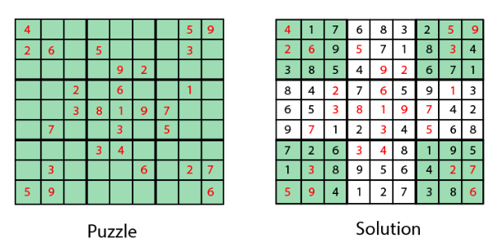
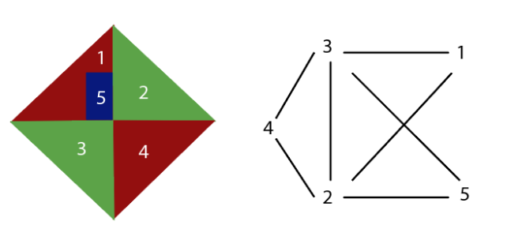
Constraint Satisfaction problems-
Graph Coloring: The problem where the constraint is that no adjacent sides can have the same color.
Sudoku Playing: The game play where the constraint is that number from 0-9 can not be repeated in the same row or column.

Slide 6
Constraint Satisfaction problems-
n-queen problem: In n-queen problem, the constraint is that no queen should be placed either diagonally, in the same row or column.
Crossword: In crossword problem, the constraint is that there should be the correct formation of the words, and it should be meaningful.
Latin square Problem: In this game, the task is to search the pattern which is occurring several times in the game. They may be shuffled but will contain the same digits.
Cryptarithmetic Problem: This problem has one most important constraint that is, we cannot assign a different digit to the same character. All digits should contain a unique alphabet.

Slide 7
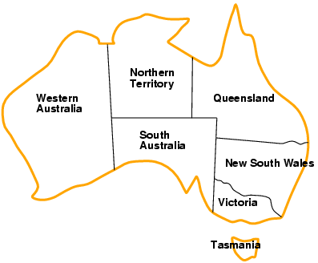
Example: Map-Coloring
Variables WA, NT, Q, NSW, V, SA, T
Domains D_{i} = {red,green,blue}
Constraints: adjacent regions must have different colors
e.g., WA ≠ NT

Slide 8
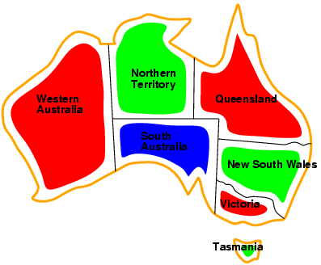
Example: Map-Coloring
Solutions are complete and consistent assignments, e.g., WA = red, NT = green,Q = red,NSW = green,V = red,SA = blue,T = green

Slide 9
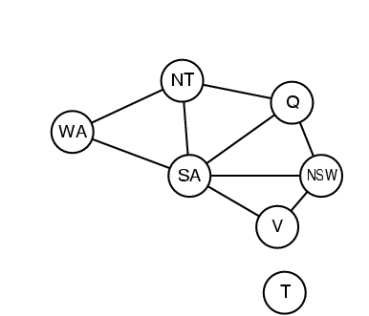
Constraint graph
Binary CSP: each constraint relates two variables
Constraint graph: nodes are variables, arcs are constraints

Slide 10
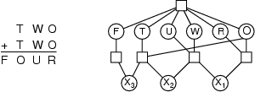
Example: Cryptarithmetic
Variables: F T U W R O X₁ X₂ X₃
Domains: {0,1,2,3,4,5,6,7,8,9} {0,1}
Constraints: Alldiff (F,T,U,W,R,O)
  O + O = R + 10 · X₁
  X₁ + W + W = U + 10 · X₂
  X₂ + T + T = O + 10 · X₃
  X₃ = F, T ≠ 0, F ≠ 0

Slide 11
Sudoku puzzle
Variables: 9x9 grid cells
Domains: Numbers from 1 to 9
Constraints: No number can repeat in the same row, column, or 3x3 subgrid.
Step 1: Start with an empty Sudoku grid.
Step 2: Apply the initial constraints for the given numbers, reducing the domains of variables based on the puzzle's clues.
Step 3: Use constraint propagation to narrow down the domains further. For example, if a row has two cells with domains {2, 5}, and the constraint specifies that these two cells cannot have the same number, we can eliminate the possibility of 5 for one of them.
Step 4: Continue applying constraints and propagating until the domains of variables are either empty or filled with single values. If they are all filled, you have a valid solution. If any variable's domain is empty, you backtrack to the previous step and try an alternative assignment.

Slide 12
Adversarial Search
Search in which two or more players with conflicting goals are trying to explore the same search space for the solution, are called adversarial search, often known as Games.
Adversarial search is basically a kind of search in which one can trace the movement of an enemy or opponent.
The environment with more than one agent is termed as multi-agent environment, in which each agent is an opponent of other agent and playing against each other.
Each agent needs to consider the action of other agent and effect of that action on their performance.

Slide 13
Game Playing: Adversarial search
Ex. game playing.
chess, business strategy tools, trading kind of websites, and war-based games .
In an adversarial search, the user can change the current state but has no control over the next state.
The next state control is in the hands of the opponent and is unpredictable.
adversarial search – these problems are called as games

Slide 14
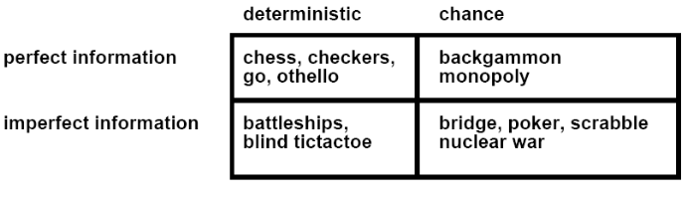
Type of Games

Slide 15
Type of Games
Perfect information: Agents have all the information about the game, Examples are Chess, Checkers, Go, etc.
Imperfect information: If in a game agents do not have all information about the game and not aware with what's going on, such as tic-tac-toe, Battleship, blind, Bridge, etc.
Deterministic games: Deterministic games are those games which follow a strict pattern and set of rules for the games. Examples are chess, Checkers, Go, tic-tac-toe, etc.
Non-deterministic games: Non-deterministic are those games which have various unpredictable events and has a factor of chance or luck. Example: Backgammon, Monopoly, Poker, etc.

Slide 16
Adversarial search
In this search we will consider deterministic games, fully observable environment, zero-sum, and where each agent acts alternatively.
Zero-Sum Game
In Zero-sum game each agent's gain or loss of utility is exactly balanced by the losses or gains of utility of another agent.
One player of the game try to maximize one single value, while other player tries to minimize it.
Each move by one player in the game is called as ply.
Chess and tic-tac-toe are examples of a Zero-sum game.

Slide 17
Formalization of the problem:
Initial state: It specifies how the game is set up at the start.
Player(s): It specifies which player has moved in the state space.
Action(s): It returns the set of legal moves in state space.
Result(s, a): It is the transition model, which specifies the result of moves in the state space.
Terminal-Test(s): Terminal test is true if the game is over, else it is false at any case. The state where the game ends is called terminal states.
Utility(s, p): A utility function gives the final numeric value for a game that ends in terminal states s for player p. It is also called payoff function. For Chess, the outcomes are a win, loss, or draw and its payoff values are +1, 0, ½. And for tic-tac-toe, utility values are +1, -1, and 0.

Slide 18
Game tree:
A game tree is a tree where nodes of the tree are the game states and Edges of the tree are the moves by players.
Game tree involves initial state, actions function, and result Function.
The following figure is showing part of the game-tree for tic-tac-toe game. Following are some key points of the game:
There are two players MAX and MIN.
Players have an alternate turn and start with MAX.
MAX maximizes the result of the game tree
MIN minimizes the result.

Slide 19
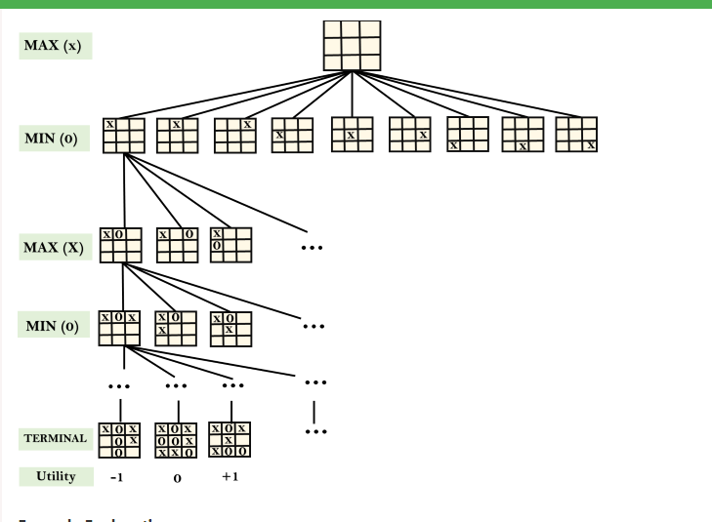

Slide 20
From the initial state, MAX has 9 possible moves as he starts first. MAX place x and MIN place o, and both player plays alternatively until we reach a leaf node where one player has three in a row or all squares are filled.
Both players will compute each node, minimax, the minimax value which is the best achievable utility against an optimal adversary.
Suppose both the players are well aware of the tic-tac-toe and playing the best play.
Each player is doing his best to prevent another one from winning. MIN is acting against Max in the game.

Slide 21
So in the game tree, we have a layer of Max, a layer of MIN, and each layer is called as Ply. Max place x, then MIN puts o to prevent Max from winning, and this game continues until the terminal node.
In this either MIN wins, MAX wins, or it's a draw.
This game-tree is the whole search space of possibilities that MIN and MAX are playing tic-tac-toe and taking turns alternately.

Slide 22
Adversarial Search for the minimax procedure works as follows:
It aims to find the optimal strategy for MAX to win the game.
It follows the approach of Depth-first search.
In the game tree, optimal leaf node could appear at any depth of the tree.
Propagate the minimax values up to the tree until the terminal node discovered.

Slide 23
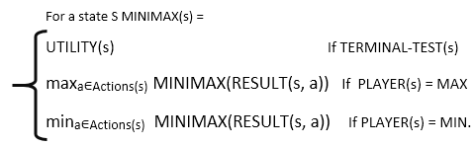
In a given game tree, the optimal strategy can be determined from the minimax value of each node, which can be written as MINIMAX(n). MAX prefer to move to a state of maximum value and MIN prefer to move to a state of minimum value then:

Slide 24
Min-Max Algorithm
Min-max algorithm is a recursive or backtracking algorithm which is used in decision-making and game theory.
Min-Max algorithm uses recursion to search through the game-tree.
In this algorithm two players play the game, one is called MAX and other is called MIN.
Both Players of the game are opponent of each other, where MAX will select the maximized value and MIN will select the minimized value.
The minimax algorithm performs a depth-first search algorithm for the exploration of the complete game tree.
The minimax algorithm proceeds all the way down to the terminal node of the tree, then backtrack the tree as the recursion.

Slide 25
Pseudo-code for MinMax Algorithm:
function minimax(node, depth, maximizingPlayer) is
if depth ==0 or node is a terminal node then
return static evaluation of node
if MaximizingPlayer then // for Maximizer Player
maxEva= -infinity
for each child of node do
eva= minimax(child, depth-1, false)
maxEva= max(maxEva,eva) //gives Maximum of the values
return maxEva
else // for Minimizer player
minEva= +infinity
for each child of node do
eva= minimax(child, depth-1, true)
minEva= min(minEva, eva) //gives minimum of the values
return minEva

Slide 26
Properties of Mini-Max algorithm:
Complete- Min-Max algorithm is Complete. It will definitely find a solution (if exist), in the finite search tree.
Optimal- Min-Max algorithm is optimal if both opponents are playing optimally.
Time complexity- As it performs DFS for the game-tree, so the time complexity of Min-Max algorithm is O(b^{m}), where b is branching factor of the game-tree, and m is the maximum depth of the tree.
Space Complexity- Space complexity of Mini-max algorithm is also similar to DFS which is O(bm).

Slide 27
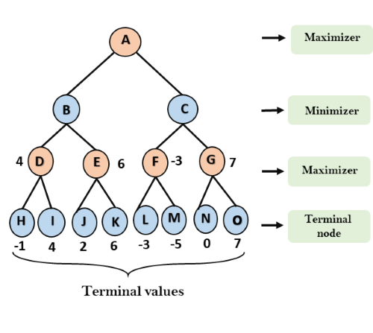
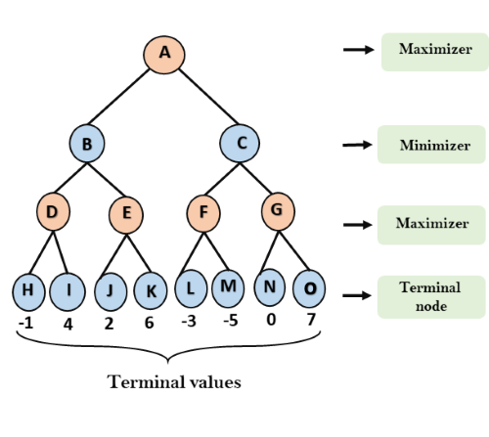
Example
initial value is -∞,
It will find the maximum among the all.
For node D max(-1,- -∞) => max(-1,4)= 4
For Node E max(2, -∞) => max(2, 6)= 6
For Node F max(-3, -∞) => max(-3,-5) = -3
For node G max(0, -∞) = max(0, 7) = 7

Slide 28
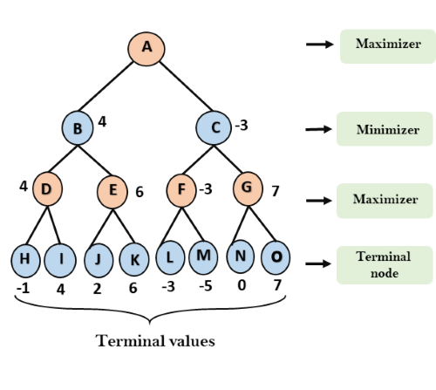
Step 3: In the next step, it's a turn for minimizer, so it will compare all nodes value with +∞, and will find the 3rd layer node values.
For node B= min(4,6) = 4
For node C= min (-3, 7) = -3

Slide 29
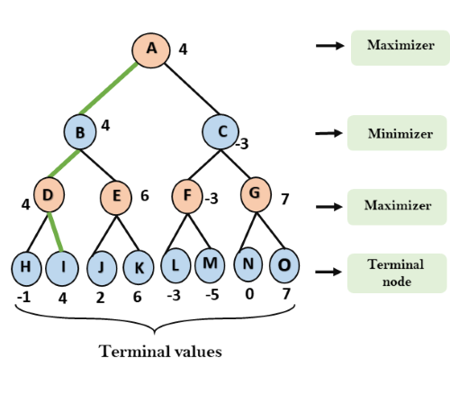
Step 4: Now it's a turn for Maximizer, and it will again choose the maximum of all nodes value and find the maximum value for the root node.
For node A max(4, -3)= 4

Slide 30
Limitation of the minimax Algorithm:
The main drawback of the minimax algorithm is that it gets really slow for complex games such as Chess, go, etc.
This type of games has a huge branching factor, and the player has lots of choices to decide.
This limitation of the minimax algorithm can be improved from alpha-beta pruning .

Slide 31
Alpha-Beta Pruning
Alpha-beta pruning is a modified version of the minimax algorithm. It is an optimization technique for the minimax algorithm.
In minimax search algorithm that the number of game states it has to examine are exponential in depth of the tree.
we can cut it to half using alpha-beta pruning.
without checking each node of the game tree we can compute the correct minimax decision by the technique pruning.
This involves two threshold parameter Alpha and beta for future expansion, so it is called alpha-beta pruning.
It is also called as Alpha-Beta Algorithm.

Slide 32
Alpha-Beta Pruning
Alpha-beta pruning can be applied at any depth of a tree, and sometimes it not only prune the tree leaves but also entire sub-tree.
The two-parameter can be defined as:
  Alpha: The best (highest-value) choice we have found so far at any point along the path of Maximizer. The initial value of alpha is -∞.
  Beta: The best (lowest-value) choice we have found so far at any point along the path of Minimizer. The initial value of beta is +∞.

Slide 33
Alpha-Beta Pruning
The Alpha-beta pruning to a standard minimax algorithm returns the same move as the standard algorithm does, but it removes all the nodes which are not really affecting the final decision but making algorithm slow. Hence by pruning these nodes, it makes the algorithm fast.

Slide 34
Condition for Alpha-beta pruning:
α>=β
Key points about alpha-beta pruning:
The Max player will only update the value of alpha.
The Min player will only update the value of beta.
While backtracking the tree, the node values will be passed to upper nodes instead of values of alpha and beta.
We can only pass the alpha, beta values to the child nodes.

Slide 35
Pseudo-code for Alpha-beta Pruning:
function minimax(node, depth, alpha, beta, maximizingPlayer)
if depth ==0 or node is a terminal node then
return static evaluation of node
if MaximizingPlayer then // for Maximizer Player
maxEva= -infinity
for each child of node do
eva= minimax(child, depth-1, alpha, beta, False)
maxEva= max(maxEva, eva)
alpha= max(alpha, maxEva)
if beta<=alpha
break
return maxEva
else // for Minimizer player
minEva= +infinity
for each child of node do
eva= minimax(child, depth-1, alpha, beta, true)
minEva= min(minEva, eva)
beta= min(beta, eva)
if beta<=alpha
break
return minEva

Slide 36
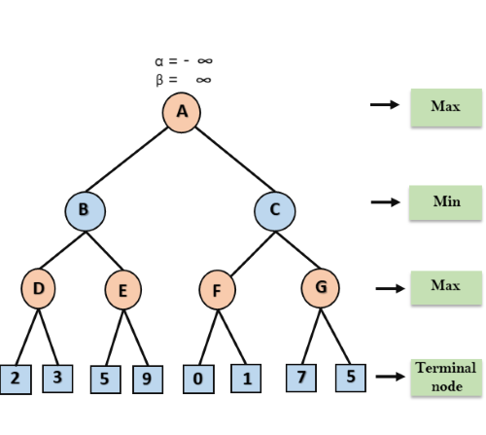
Alpha-beta Pruning:

Slide 37
Alpha-beta Pruning:
Step 1: At the first step the, Max player will start first move from node A where α= -∞ and β= +∞, these value of alpha and beta passed down to node B where again α= -∞ and β= +∞, and Node B passes the same value to its child D.
Step 2: At Node D, the value of α will be calculated as its turn for Max. The value of α is compared with firstly 2 and then 3, and the max (2, 3) = 3 will be the value of α at node D and node value will also 3.
Step 3: Now algorithm backtrack to node B, where the value of β will change as this is a turn of Min, Now β= +∞, will compare with the available subsequent nodes value, i.e. min (∞, 3) = 3, hence at node B now α= -∞, and β= 3.

Slide 38
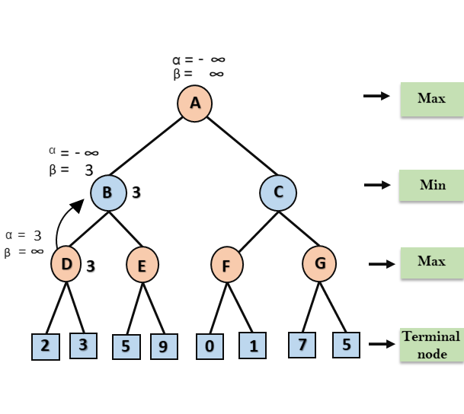
Alpha-beta Pruning:

Slide 39
Alpha-beta Pruning:
In the next step, algorithm traverse the next successor of Node B which is node E, and the values of α= -∞, and β= 3 will also be passed.
Step 4: At node E, Max will take its turn, and the value of alpha will change. The current value of alpha will be compared with 5, so max (-∞, 5) = 5, hence at node E α= 5 and β= 3, where α>=β, so the right successor of E will be pruned, and algorithm will not traverse it, and the value at node E will be 5.

Slide 40
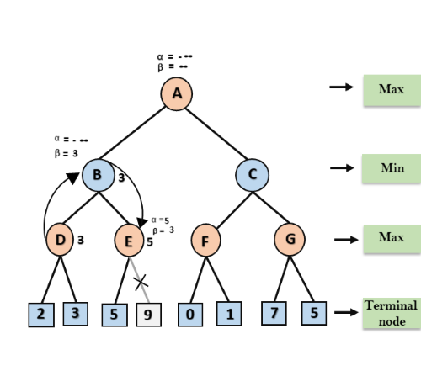
Alpha-beta Pruning:

Slide 41
Alpha-beta Pruning:
Step 5: At next step, algorithm again backtrack the tree, from node B to node A. At node A, the value of alpha will be changed the maximum available value is 3 as max (-∞, 3)= 3, and β= +∞, these two values now passes to right successor of A which is Node C.
At node C, α=3 and β= +∞, and the same values will be passed on to node F.
Step 6: At node F, again the value of α will be compared with left child which is 0, and max(3,0)= 3, and then compared with right child which is 1, and max(3,1)= 3 still α remains 3, but the node value of F will become 1.

Slide 42
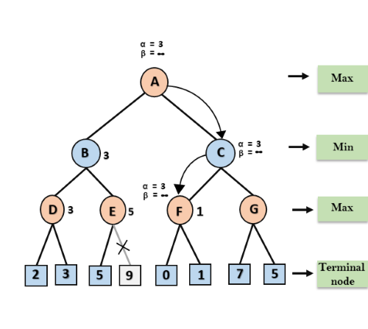
Alpha-beta Pruning:

Slide 43
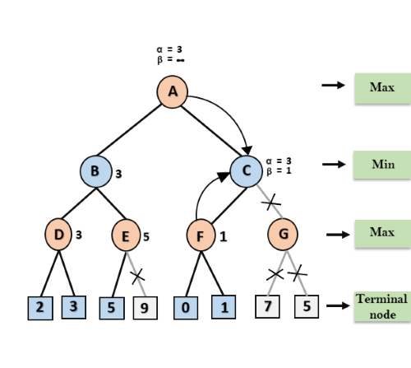
Alpha-beta Pruning:

Slide 44
Alpha-beta Pruning:
Step 7: Node F returns the node value 1 to node C, at C α= 3 and β= +∞, here the value of beta will be changed, it will compare with 1 so min (∞, 1) = 1. Now at C, α=3 and β= 1, and again it satisfies the condition α>=β, so the next child of C which is G will be pruned, and the algorithm will not compute the entire sub-tree G.
Step 8: C now returns the value of 1 to A here the best value for A is max (3, 1) = 3. Following is the final game tree which is the showing the nodes which are computed and nodes which has never computed. Hence the optimal value for the maximizer is 3 for this example.

Slide 45
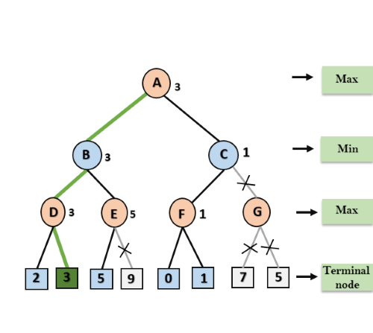
Alpha-beta Pruning:

Slide 46
Alpha-beta Pruning:

